Slide 1
Smart Facial attendance monitoring system
FINAL REPORT PPT
Presented by : Mayank Verma(1727706)
Rahul Raj(1727747)
Vivek Kumar(1816815)

Slide 2
Introduction
This Project aims to revolutionize the traditional attendance taking method used in School and colleges.
It is designed to automatically capture the attendance of the students present in the class by recognizing their faces using an installed CCTV camera.
This Application uses “Image Processing” technique to take attendance.

Slide 3
1
2
3
The main objective is to automate the attendance monitoring system, that is shifting it from pen and paper attendance system to fully electronic monitoring system.
The application will not only provide necessary reports to the teacher but it will also provide valuable feedbacks and comments to the students also, through this they can also keep track of their attendance
To save the valuable time ,of both students and teachers that was getting consumed while taking attendance in every lecture.
This application will save at least 10 minutes in each lecture.
Objectives

Slide 4
Literature Findings:
Over the last decade, face recognition has become one of the most active applications of visual recognition due to its potential value for law enforcement, surveillance and human-computer interaction
Eigenface is one of the most thoroughly investigated approaches to face recognition.
It is also known as Karhunen- Loève expansion, eigenpicture, eigenvector, and principal component . In mathematical terms, eigenfaces are the principal components of the distribution of faces, or the eigenvectors of the covariance matrix of the set of face
images
Face recognition starts with the detection of face patterns in sometimes cluttered scenes, proceeds by normalizing the face images to account for geometrical and illumination changes, possibly using information about the location and appearance of facial landmarks, identifies the faces using appropriate classification algorithms, and post processes the results using model-based schemes and logistic feedback

Slide 5
Problem Formulation :
Currently to keep track of students attending the classes, the attendance records are taken manually
This process is not only tedious and also very time consuming , this manual method is easily prone to proxies, it is very difficult to manage and analyze the student data manually
Also if some analyzed information is required urgently then to obtain that ,is very difficult
To solve this problem we are providing a better alternative solution through our Smart Facial Attendance Monitoring System
This Application help them to take the attendance with the help of camera installed in the classroom by matching it to the preset facial data-set of students
The obtained attendance record is saved electronically in a system, that will be used for further analysis which in turn saves a lot of time, money and energy.

Slide 6
Technologies Used
Python
OpenCV
Tkinter
JavaScript
1
2
3
4
=
Python is a high-level, interpreted, interactive and object-oriented scripting language. Python is designed to be highly readable. It uses English keywords frequently where as other languages use punctuation, and it has fewer syntactical constructions .
OpenCV is an open source computer vision and machine learning software library. It has various algorithms can be used to detect and recognize faces, identify objects, classify human actions in videos, track camera movements
Tkinter is the standard GUI library for Python. Python when combined with Tkinter provides a fast and easy way to create GUI applications. Tkinter provides a powerful object-oriented interface to the Tk GUI toolkit
JavaScript is a lightweight, interpreted programming language. It is complimentary to and integrated with Java. JavaScript is very easy to implement because it is integrated with HTML. It is open and cross-platform.

Slide 7
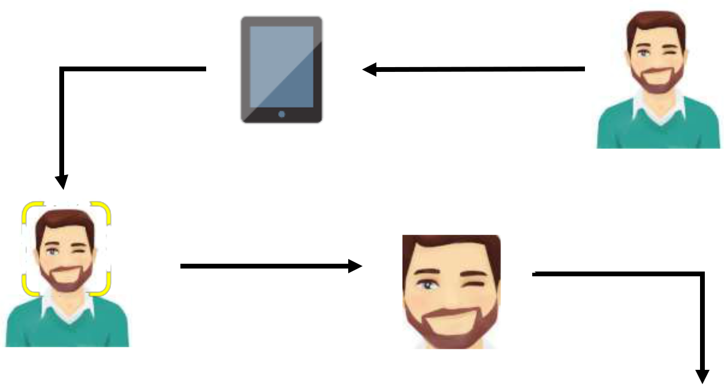

Generating Attendance Flow:
1. Student glances at the camera for Attendance
2. Student face is detected in real-time
4. The face is then identified by matching it with the recorded dataset.
3. The facial region of interest is grabbed from the frame
5.The attendance is marked for the “Present” students rest are marked “Absent”.

Slide 8
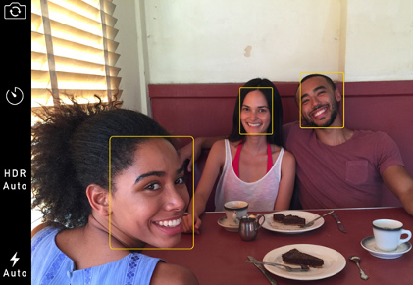
How Its Work :
Face Recognition — Step by Step
The first step in our pipeline is face detection. Face detection is a great feature for cameras. When the camera can automatically pick out faces, it can make sure that all the faces are in focus before it takes the picture. But we’ll use it for a different purpose — finding the areas of the image we want to pass on to the next step in our pipeline.
Step 1: Finding all the Faces

Slide 9
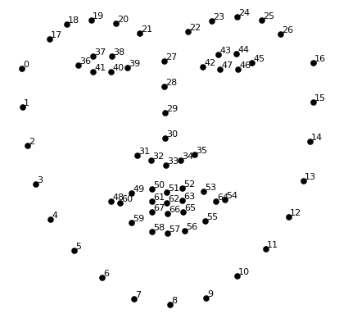
Step 2: Posing and Projecting Faces
Whew, we isolated the faces in our image. But now we have to deal with the problem that faces turned different directions look totally different to a computer.
The basic idea is we will come up with 68 specific points (called landmarks) that exist on every face — the top of the chin, the outside edge of each eye, the inner edge of each eyebrow, etc. Then we will train a machine learning algorithm to be able to find these 68 specific points on any face:
The 68 landmarks we will locate on every face.

Slide 10
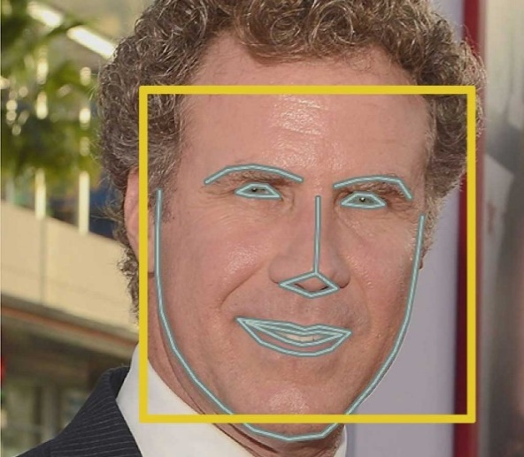
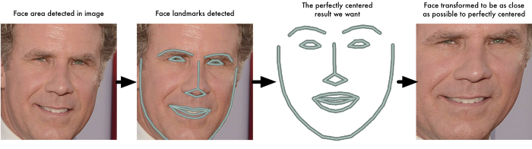
Here’s the result of locating the 68 face landmarks on our test image:
Now that we know were the eyes and mouth are, we’ll simply rotate, scale and shear the image so that the eyes and mouth are centered as best as possible.

Slide 11
Now no matter how the face is turned, we are able to center the eyes and mouth are in roughly the same position in the image. This will make our next step a lot more accurate.
Step 3: Encoding Faces
The simplest approach to face recognition is to directly compare the unknown face we found in Step 2 with all the pictures we have of people that have already been tagged.
What we need is a way to extract a few basic measurements from each face. Then we could measure our unknown face the same way and find the known face with the closest measurements.
we are going to train it to generate 128 measurements for each face.
The training process works by looking at 3 face images at a time:
1.Load a training face image of a known person
2.Load another picture of the same known person
3.Load a picture of a totally different person

Slide 12
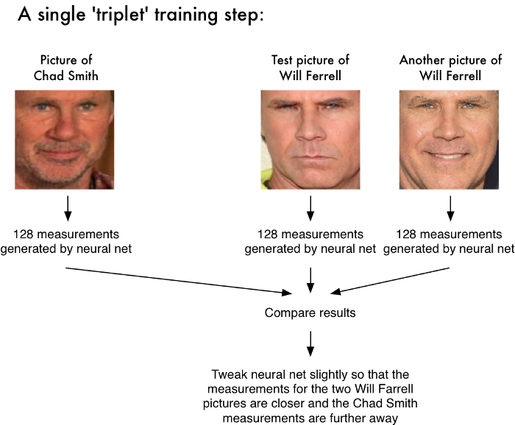
The algorithm looks at the measurements it is currently generating for each of those three images. It then tweaks the neural network slightly so that it makes sure the measurements it generates for #1 and #2 are slightly closer while making sure the measurements for #2 and #3 are slightly further apart:
After repeating this step millions of times for millions of images of thousands of different people, the neural network learns to reliably generate 128 measurements for each person.

Slide 13
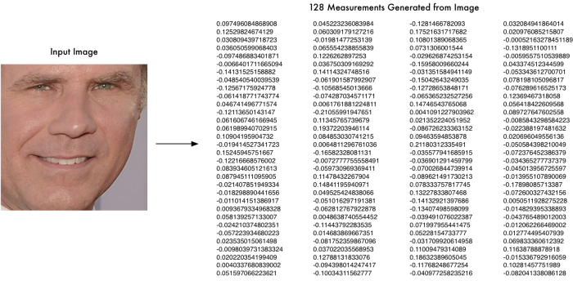
Encoding our face image
This process of training a convolutional neural network to output face embeddings requires a lot of data and computer power. once the network has been trained, it can generate measurements for any face.
So all we need to do ourselves is run our face images through their pre-trained network to get the 128 measurements for each face. Here’s the measurements for our test image:

Slide 14
Step 4: Finding the person’s name from the encoding
This last step is actually the easiest step in the whole process. All we have to do is find the person in our database of known people who has the closest measurements to our test image.
You can do that by using any basic machine learning classification algorithm. No fancy deep learning tricks are needed. We’ll use a simple linear SVM classifier, but lots of classification algorithms could work.
All we need to do is train a classifier that can take in the measurements from a new test image and tells which known person is the closest match. Running this classifier takes milliseconds. The result of the classifier is the name of the person!

Slide 15
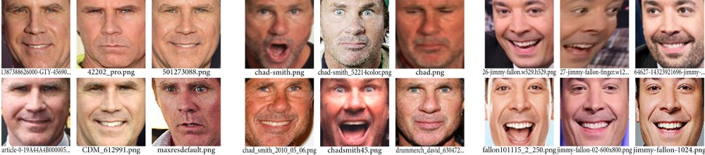
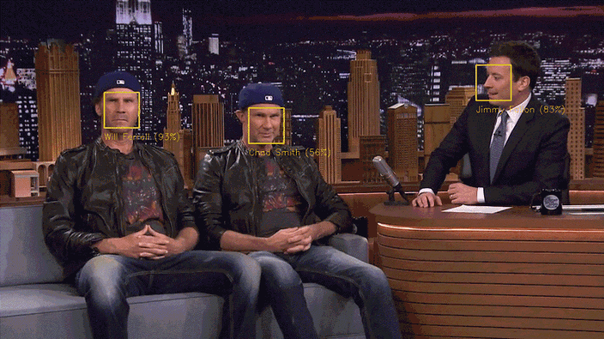
So let’s try out our system. First, I trained a classifier with the embeddings of about 20 pictures each of Will Ferrell, Chad Smith and Jimmy Falon :
Then I ran the classifier on every frame of the famous youtube video of Will Ferrell and Chad Smith pretending to be each other on the Jimmy Fallon show:

Slide 16
Conclusion :
Attendance monitoring is one of the important and repetitive task which is done in School and Colleges
every day in each lecture , which at least consumes 10 minutes in each lecture , for a college having
at least 6 lectures the total time consumed in taking attendance is more than 1 hour.
This project will help in reducing the time taken for attendance to nearly 0 , so that the time saved can be utilized in a more productive manner. It can provide a detailed attendance report which be useful for both teachers and students as well.
This project will be of huge help for the School/Colleges as it saves their lot of time, labor , and paperwork ,also as the attendance will be taken automatically , the chances of external interference and proxies are next to zero. The report generated is more accurate.

Slide 17
Thank You

